Slide 1
Advanced Machine Learning
Decision Tree Algorithm
Dr. Nwe Nwe Htay Win
Faculty of Mathematics and Science
Parami University
nwenwehtaywin@parami.edu.mm

Slide 2
Contents
Basic Concepts of Decision Tree
Core Concepts of Decision Tree
Challenges of Decision Tree

Slide 3
Basic Concepts of Decision Tree

Slide 4
Classification
Decision Trees (DTs) are a non-parametric supervised learning method used for classification and regression.
Classification trees are a type of decision tree that determine whether an event occurred or not, usually with a "yes" or "no" outcome.
They are used in data mining and machine learning to classify data into discrete classes.

Slide 5
Decision Trees
A decision tree is a flowchart-like structure where an internal node represents a feature (attribute), the branch represents a decision rule, and each leaf node represents an outcome (label).
Fly?
no
yes
Has 4 legs?
Bird
no
yes
Chicken
Dog

Slide 6
Basic Concepts of DT Classification
Root node
– No incoming edges
– Zero or more outgoing edges
Internal Node
– One incoming edge
– Two or more outgoing edges
Leaf/Terminal Node
– One incoming edges
– No outgoing edges
Fly?
no
yes
Has 4 legs?
Bird
no
yes
Chicken
Dog

Slide 7
Classification and Regression Trees
Classification Trees:
These trees are used when the target variable is categorical (i.e., it belongs to a finite set of classes or categories).
Example: Predicting whether an email is spam or not (binary classification), or identifying the species of a flower (multi-class classification).
Regression Trees:
These trees are used when the target variable is continuous (i.e., it takes on a range of values, typically real numbers).
Example: Predicting house prices, temperature, or stock market prices.

Slide 8
Decision Tree Classification Task
Training Data
ID | Income | CreditScore | LoanAmount | Approved
1 | High | Excellent | 50K | Yes
2 | Medium | Good | 30K | No
3 | Low | Poor | 20K | No
4 | High | Good | 40K | Yes
5 | Medium | Excellent | 60K | Yes
6 | Low | Fair | 25K | No
7 | High | Excellent | 70K | Yes
8 | Medium | Poor | 35K | No
9 | High | Good | 45K | Yes
10 | Low | Good | 30K | No
Tree Induction Algorithm
Induction
Model
Learn Model
Decision Tree
Testing Data
ID | Income | CreditScore | LoanAmount | Approved
11 | Low | Excellent | 55K | ?
12 | High | Good | 89K | ?
Deduction
Apply Model

Slide 9
How Decision Tree Works
Data Preparation: Input labeled data.
Splitting: Recursively divide data based on feature values.
Stopping: Stop when conditions are met (e.g., pure nodes).
Pruning: Simplify the tree to avoid overfitting.
Prediction: Use the final tree to classify new inputs.

Slide 10
Example of a Decision Tree
splitting attributes
ID | Income | CreditScore | LoanAmount | Approved
1 | High | Excellent | 50K | Yes
2 | Medium | Good | 30K | No
3 | Low | Poor | 20K | No
4 | High | Good | 40K | Yes
5 | Medium | Excellent | 60K | Yes
6 | Low | Fair | 25K | No
7 | High | Excellent | 70K | Yes
8 | Medium | Poor | 35K | No
9 | High | Good | 45K | Yes
10 | Low | Good | 30K | No
Income
Medium
Low
High
Yes
CreditScore
No
Excellent, Fair, Poor
Good
Loan Amount
No
<80k
>80K
Yes
No

Slide 11
Example of a Decision Tree
CreditScore
ID | Income | CreditScore | LoanAmount | Approved
1 | High | Excellent | 50K | Yes
2 | Medium | Good | 30K | No
3 | Low | Poor | 20K | No
4 | High | Good | 40K | Yes
5 | Medium | Excellent | 60K | Yes
6 | Low | Fair | 25K | No
7 | High | Excellent | 70K | Yes
8 | Medium | Poor | 35K | No
9 | High | Good | 45K | Yes
10 | Low | Good | 30K | No
Good, Fair
Excellent
Poor
Loan
Amount
Yes
No
<40K
>40K
Yes
No
There could be more than one tree that fits the same data!

Slide 12
Apply Model to Test Data
Start from the root of tree.
Test Data
ID | Income | CreditScore | LoanAmount | Approved
11 | High | Excellent | 55K | ?
Income
High
Low
CreditScore
No
Excellent, Fair, Poor
Good
Loan Amount
No
<80k
>80K
Yes
No

Slide 13
Decision Tree Induction
Many Algorithms
ID3, C4.5
SLIQ, SPRINT
CART
CHAID , etc

Slide 14
Tree Induction
Greedy Strategy
Split the records based on an attribute test that optimizes certain criterion.
Issues
Determine how to split the records
How to specify the attribute test conditions?
How to determine the best split?
Determine when to stop splitting

Slide 15
How to Specify Test Condition?
Depends on attribute types
Nominal
Ordinal
Continuous
Depends on number of ways to split
2-way split
Multi way split

Slide 16
Splitting Based on Nominal Attribute
Multiway split: Use as many partitions as distinct values.
Binary Split: Divides values into two subsets.
Need to find optimal partitioning.
CarType
Luxury
Family
Sports
CarType
CarType
OR
{Family, Luxury}
{Sports, Luxury}
{Family}
{Sports}

Slide 17
Splitting Based on Ordinal Attribute
Multiway split: Use as many partitions as distinct values.
Binary Split: Divides values into two subsets.
Need to find optimal partitioning.
Size
Large
Small
Medium
CarType
CarType
OR
{Medium, Large}
{Small, Medium}
{Large}
{Small}

Slide 18
Splitting Based on Continuous Attribute
Different ways of handing
Discretization to form an ordinal categorical attribute
Static – discretize once at the beginning
Dynamic – ranges can be found by equal interval bucketing, equal frequency bucketing (percentiles), or clustering
Binary Decision: (A<V) or (A >= V)
Consider all possible splits and finds the best cut
Can be more computationally intensive

Slide 19
Splitting based on continuous attributes
Taxable Income ?
Taxable Income > 80K
[10K, 25K)
[50K, 90K)
Yes
No
[25K, 50K)
(i) Binary Split
(i) Multi-way Split

Slide 20
How to determine the Best Split ?
Before Splitting : 10 records of class 0,
10 records of class 1
C0 : 10
C1: 10
Customer ID
Car Type
Gender
Br1
Br10
Family
Luxury
Male
Female
Sports
Br19
C0: 1
C1: 7
C0: 1
C1: 3
C0: 8
C1: 0
C0: 1
C1: 7
C0: 6
C1: 4
C0: 6
C1: 4
C0: 1
C1: 3
C0: 8
C1: 0
………..
Which test condition is the best?

Slide 21
How to determine the best split ?
Greedy approach:
Nodes with homogeneous class distribution are preferred.
Need a measure of node impurity.
C0 : 10
C1: 10
C0 : 9
C1: 1
Non-homogeneous
High degree of Impurity
Homogenous
Low degree of impurity

Slide 22

Measures of Node Impurity
p(i|t): fraction of records associated with node t belonging to class i
$Entropy\left(t\right)=−\sum_{i=0}^{c−1}{p\left(i | t\right)\log_{2}p\left(i | t\right)}$
$Gini\left(t\right)=1−\sum_{i=0}^{c−1}{{[p(i|t)]}^{2}}$

Slide 23
Impurity Measures in Decision Trees
Impurity measures are used to determine how "mixed" the data is at each node of the tree.
The goal is to split the data at each node such that the resulting subsets are as pure as possible.
Several impurity measures are commonly used to evaluate potential splits, such as Gini Index, Information Gain, Chi-Square, Entropy, and others.

Slide 24
Gini Index
The Gini Index is one of the most commonly used impurity measures in decision trees, especially for classification tasks (like in CART).
The Gini index calculates the "impurity" of a node, i.e., how mixed the classes are in the dataset.
To calculate the Gini Index for the dataset, we first need to:
Understand the data structure and the target variable (Approved in this case).
Split the dataset based on one of the features (e.g., Income, CreditScore, or LoanAmount).
Calculate the Gini Index for each split.

Slide 25
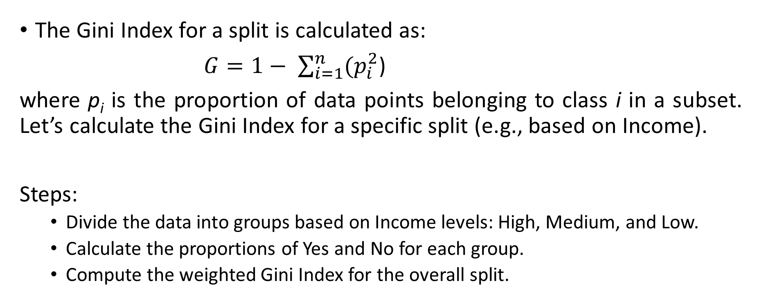
Gini Index Formula
The Gini Index for a split is calculated as:
$G=1− \sum_{i=1}^{n}{{(p}_{i}^{2}}$)
where p_{i} is the proportion of data points belonging to class i in a subset. Let’s calculate the Gini Index for a specific split (e.g., based on Income).
Steps:
Divide the data into groups based on Income levels: High, Medium, and Low.
Calculate the proportions of Yes and No for each group.
Compute the weighted Gini Index for the overall split.

Slide 26

Gini Index calculation -1 Step1: Gini Index for Entire Dataset
The Gini index for the entire dataset is calculated using target variable (Approved).
Total rows= 10
Yes=5, No=5
Gini= 1 – ($p_{Yes}^{2}+p_{No}^{2})$
$$Gini=1−\left({\left(\frac{5}{10}\right)}^{2}+{\frac{5}{10}}^{2}\right)=1−\left(0.25+0.25\right)=0.5$$
The Gini index for the full dataset is 0.5.
ID | Income | CreditScore | LoanAmount | Approved
1 | High | Excellent | 50K | Yes
2 | Medium | Good | 30K | No
3 | Low | Poor | 20K | No
4 | High | Good | 40K | Yes
5 | Medium | Excellent | 60K | Yes
6 | Low | Fair | 25K | No
7 | High | Excellent | 70K | Yes
8 | Medium | Poor | 35K | No
9 | High | Good | 45K | Yes
10 | Low | Good | 30K | No

Slide 27
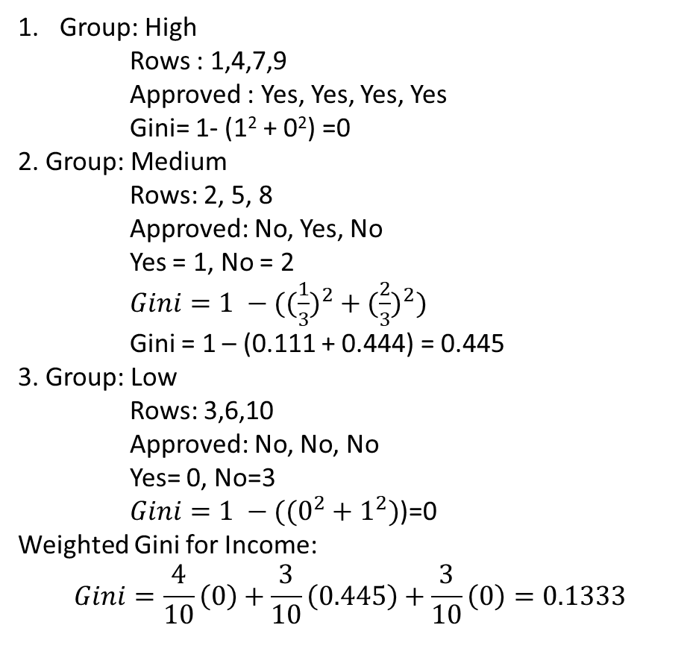
Gini Index calculation -2 Step 2: Splitting on Income
Income has three categories: High, Medium, and Low.
Group: High
Rows : 1,4,7,9
Approved : Yes, Yes, Yes, Yes
Gini= 1- (1² + 0²) =0
2. Group: Medium
Rows: 2, 5, 8
Approved: No, Yes, No
Yes = 1, No = 2
$Gini=1 −(({\frac{1}{3})}^{2}+({\frac{2}{3})}^{2})$
Gini = 1 – (0.111 + 0.444) = 0.445
3. Group: Low
Rows: 3,6,10
Approved: No, No, No
Yes= 0, No=3
$Gini=1 −((0^{2}+1^{2})$)=0
Weighted Gini for Income:
$$Gini=\frac{4}{10}\left(0\right)+\frac{3}{10}\left(0.445\right)+\frac{3}{10}\left(0\right)=0.1333$$
ID | Income | CreditScore | LoanAmount | Approved
1 | High | Excellent | 50K | Yes
2 | Medium | Good | 30K | No
3 | Low | Poor | 20K | No
4 | High | Good | 40K | Yes
5 | Medium | Excellent | 60K | Yes
6 | Low | Fair | 25K | No
7 | High | Excellent | 70K | Yes
8 | Medium | Poor | 35K | No
9 | High | Good | 45K | Yes
10 | Low | Good | 30K | No

Slide 28

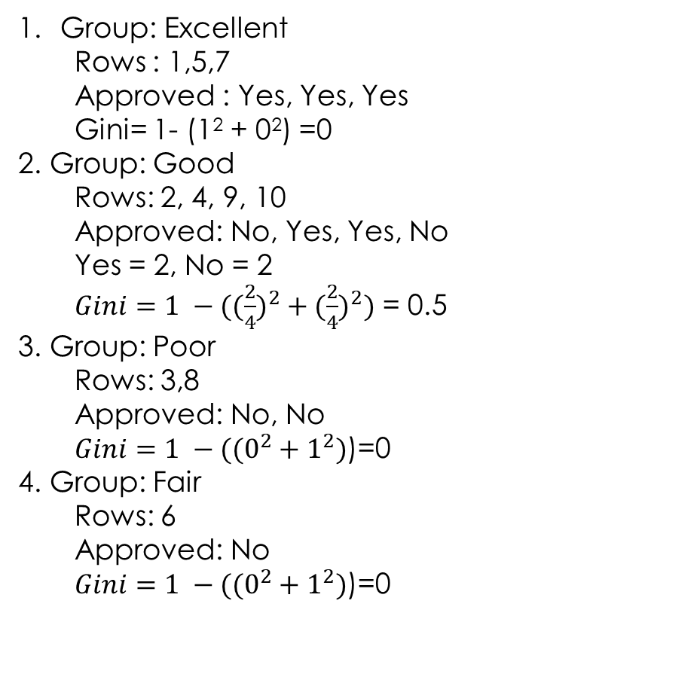
Gini Index calculation -3 Step 2: Splitting on CreditScore
CreditScore has four categories: Excellent, Good, Poor, and Fair.
ID | Income | CreditScore | LoanAmount | Approved
1 | High | Excellent | 50K | Yes
2 | Medium | Good | 30K | No
3 | Low | Poor | 20K | No
4 | High | Good | 40K | Yes
5 | Medium | Excellent | 60K | Yes
6 | Low | Fair | 25K | No
7 | High | Excellent | 70K | Yes
8 | Medium | Poor | 35K | No
9 | High | Good | 45K | Yes
10 | Low | Good | 30K | No
Group: Excellent
Rows : 1,5,7
Approved : Yes, Yes, Yes
Gini= 1- (1² + 0²) =0
2. Group: Good
Rows: 2, 4, 9, 10
Approved: No, Yes, Yes, No
Yes = 2, No = 2
$Gini=1 −(({\frac{2}{4})}^{2}+({\frac{2}{4})}^{2})$ = 0.5
3. Group: Poor
Rows: 3,8
Approved: No, No
$Gini=1 −((0^{2}+1^{2})$)=0
4. Group: Fair
Rows: 6
Approved: No
$Gini=1 −((0^{2}+1^{2})$)=0
Weighted Gini for CreditScore:
$$Gini=\frac{3}{10}\left(0\right)+\frac{4}{10}\left(0.5\right)+\frac{2}{10}\left(0\right)+\frac{1}{10}(0)=0.2$$

Slide 29
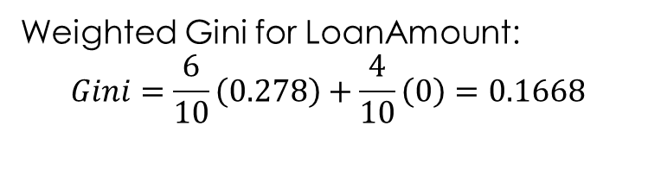
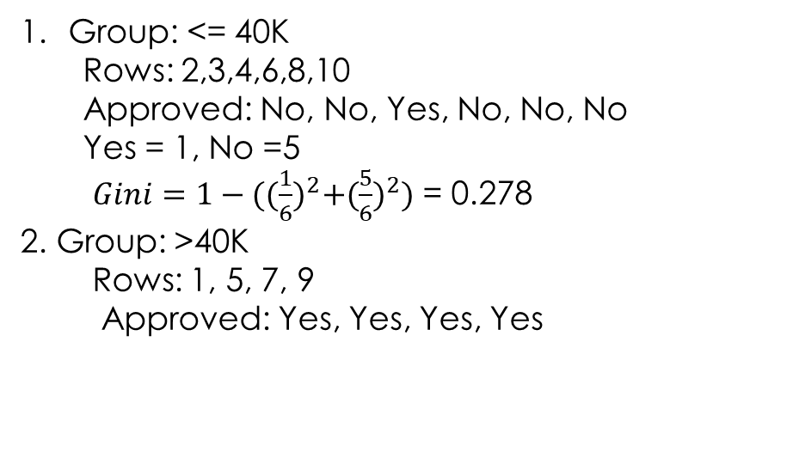
Gini Index calculation -4 Step 2: Splitting on LoanAmount
We divide the data into splits based on Loan Amount thresholds (e.g., ≤40K and >40K)
ID | Income | CreditScore | LoanAmount | Approved
1 | High | Excellent | 50K | Yes
2 | Medium | Good | 30K | No
3 | Low | Poor | 20K | No
4 | High | Good | 40K | Yes
5 | Medium | Excellent | 60K | Yes
6 | Low | Fair | 25K | No
7 | High | Excellent | 70K | Yes
8 | Medium | Poor | 35K | No
9 | High | Good | 45K | Yes
10 | Low | Good | 30K | No
Group: <= 40K
Rows: 2,3,4,6,8,10
Approved: No, No, Yes, No, No, No
Yes = 1, No =5
$Gini=1−({(\frac{1}{6})}^{2}+{(\frac{5}{6})}^{2})$ = 0.278
2. Group: >40K
Rows: 1, 5, 7, 9
Approved: Yes, Yes, Yes, Yes
Weighted Gini for LoanAmount:
$$Gini=\frac{6}{10}\left(0.278\right)+\frac{4}{10}\left(0\right)=0.1668$$

Slide 30
Gini Index calculation -4 Step 3: Selection the Best Split
Gini for Income: 0.1333
Gini for CreditScore: 0.2
Gini for LoanAmount: 0.1668
The best split is on Income.

Slide 31
Gini Index calculation -5 Step 4: Splitting on Income
We now split the dataset into groups based on Income and repeat the process for each group until all groups are pure or meet a stopping criterion.
Group: High
All approvals are Yes, so this is a leaf node.
Group: Medium
Split further based on the next best feature (e.g., CreditScore).
Group: Low
All approvals are No, so this is a leaf node.
Income
Medium
Low
High
?
No
Yes
Excellent, Fair, Poor
?
?
?
?

Slide 32
Gini Index calculation -5 Step 5: Repeat the Process
For Medium, repeat the Gini calculations to find the next best split (likely CreditScore or LoanAmount), and continue until all nodes are pure.

Slide 33
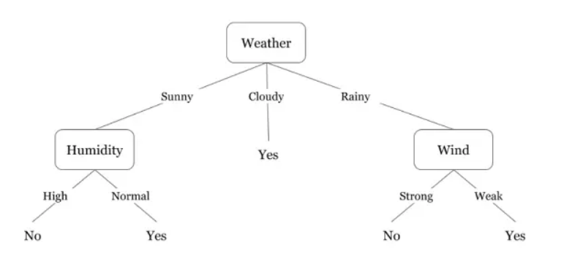
Decision Tree
Day | Weather | Temperature | Humidity | Wind | Play
1 | Sunny | Hot | High | Weak | No
2 | Cloudy | Hot | High | Weak | Yes
3 | Sunny | Mild | Normal | Strong | Yes
4 | Cloudy | Mild | High | Strong | Yes
5 | Rainy | Mild | High | Strong | No
6 | Rainy | Cool | Normal | Strong | No
7 | Rainy | Mild | High | Weak | Yes
8 | Sunny | Hot | High | Strong | No
9 | Cloudy | Hot | Normal | Weak | Yes
10 | Rainy | Mild | High | Strong | No

Slide 34
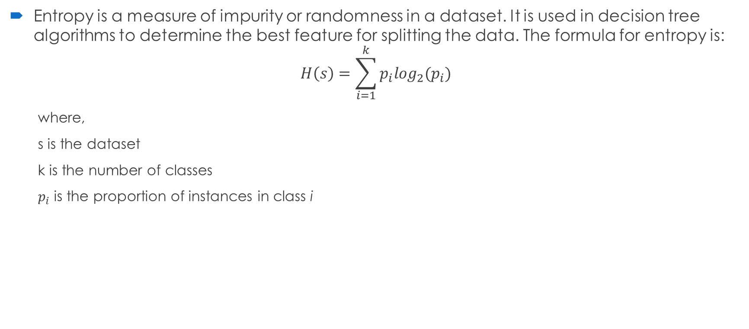
Entropy
Entropy is a measure of impurity or randomness in a dataset. It is used in decision tree algorithms to determine the best feature for splitting the data. The formula for entropy is:
$$H\left(s\right)=\sum_{i=1}^{k}{p_{i}\log_{2}(p_{i})}$$
where,
s is the dataset
k is the number of classes
$p_{i}$ is the proportion of instances in class i

Slide 35
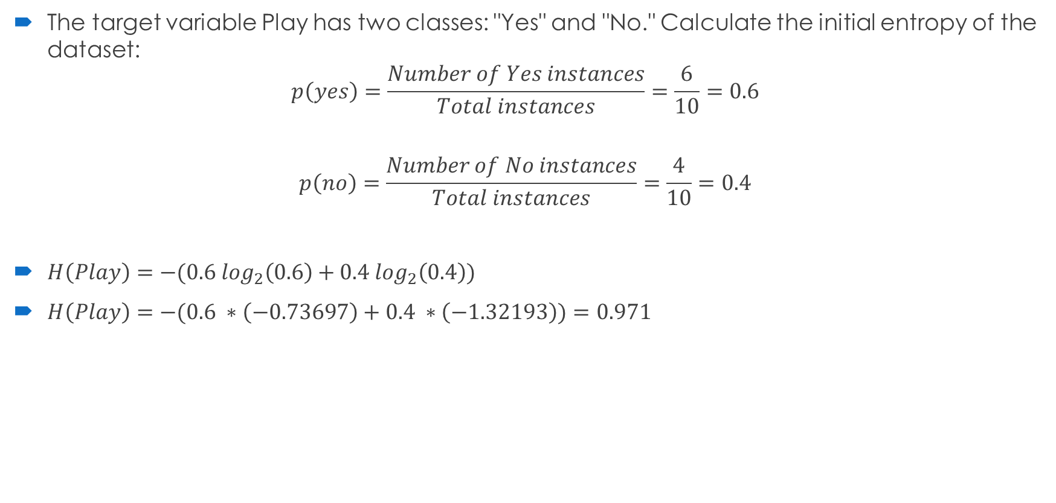
Step1: Initial Entropy
The target variable Play has two classes: "Yes" and "No." Calculate the initial entropy of the dataset:
$$p\left(yes\right)=\frac{Number of Yes instances}{Total instances}=\frac{6}{10}=0.6$$
$$p\left(no\right)=\frac{Number of No instances}{Total instances}=\frac{4}{10}=0.4$$
$H\left(Play\right)=−(0.6 \log_{2}\left(0.6\right)+0.4 \log_{2}\left(0.4\right))$
$H\left(Play\right)=−(0.6 ∗\left(−0.73697\right)+0.4 ∗\left(−1.32193\right))=0.971$

Slide 36
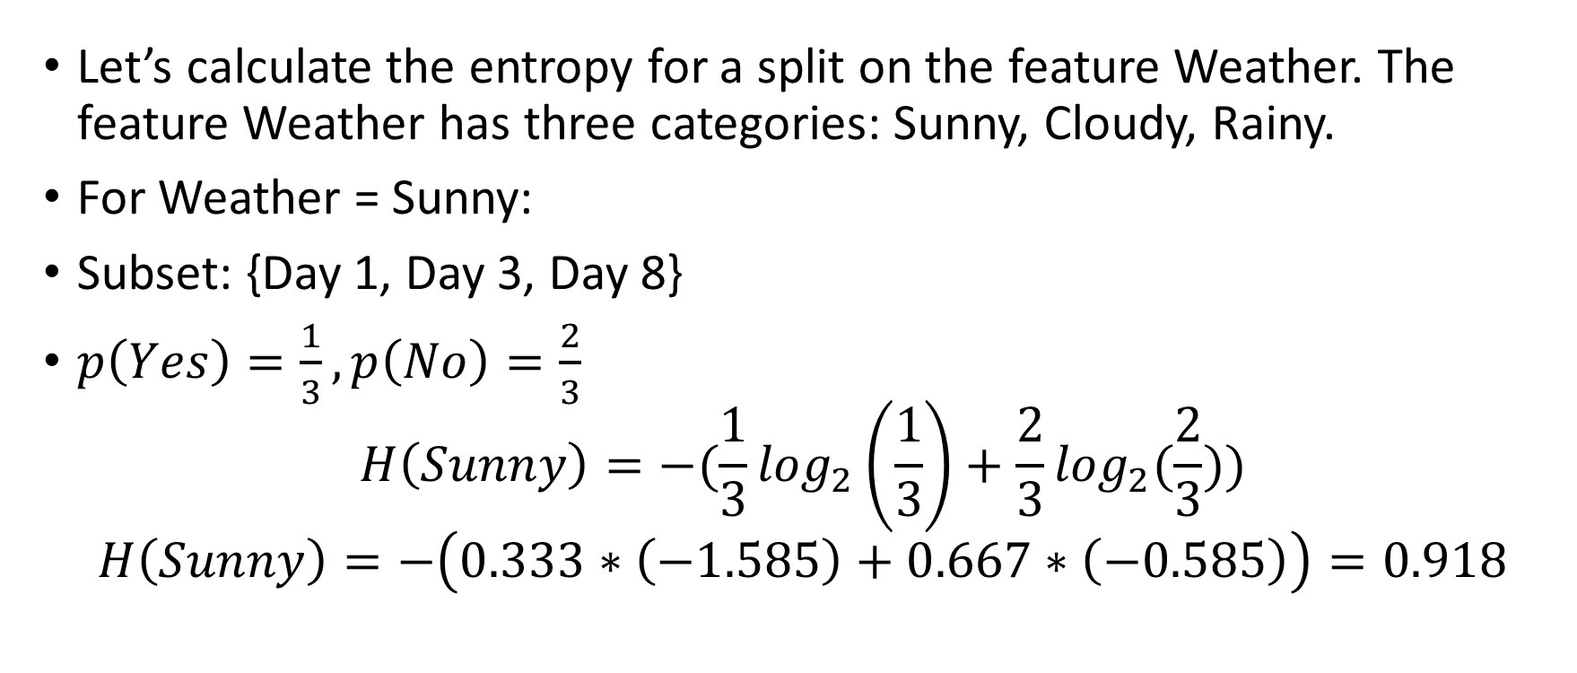
Step 2: Entropy for Splits
Let’s calculate the entropy for a split on the feature Weather. The feature Weather has three categories: Sunny, Cloudy, Rainy.
For Weather = Sunny:
Subset: {Day 1, Day 3, Day 8}
$p\left(Yes\right)=\frac{1}{3},p\left(No\right)=\frac{2}{3}$
$$H\left(Sunny\right)=−(\frac{1}{3}\log_{2}\left(\frac{1}{3}\right)+\frac{2}{3}\log_{2}(\frac{2}{3}))$$
$$H\left(Sunny\right)=−\left(0.333∗\left(−1.585\right)+0.667∗\left(−0.585\right)\right)=0.918$$

Slide 37
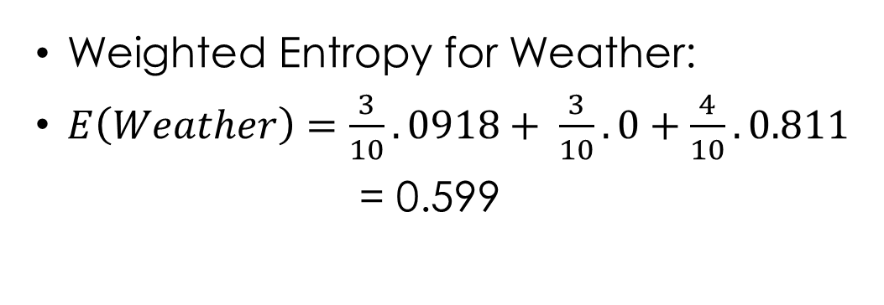

Step 2: Entropy for Splits
For Weather = Cloudy:
$H\left(Cloudy\right)=−\left(1. \log_{2}\left(1\right)+0.\log_{2}(0)\right)$=0
For Weather=Rainy:
$H\left(Rainy\right)=−\left(\frac{3}{4}.\log_{2}\frac{3}{4}+\frac{1}{4}.\log_{2}\frac{1}{4}\right)=0.811$
Day | Weather | Temperature | Humidity | Wind | Play
1 | Sunny | Hot | High | Weak | No
2 | Cloudy | Hot | High | Weak | Yes
3 | Sunny | Mild | Normal | Strong | Yes
4 | Cloudy | Mild | High | Strong | Yes
5 | Rainy | Mild | High | Strong | No
6 | Rainy | Cool | Normal | Strong | No
7 | Rainy | Mild | High | Weak | Yes
8 | Sunny | Hot | High | Strong | No
9 | Cloudy | Hot | Normal | Weak | Yes
10 | Rainy | Mild | High | Strong | No
Weighted Entropy for Weather:
$E\left(Weather\right)=\frac{3}{10}. 0918+ \frac{3}{10}.0+\frac{4}{10}.0.811$
= 0.599

Slide 38
Step 2: Entropy for Splits
Day | Weather | Temperature | Humidity | Wind | Play
1 | Sunny | Hot | High | Weak | No
2 | Cloudy | Hot | High | Weak | Yes
3 | Sunny | Mild | Normal | Strong | Yes
4 | Cloudy | Mild | High | Strong | Yes
5 | Rainy | Mild | High | Strong | No
6 | Rainy | Cool | Normal | Strong | No
7 | Rainy | Mild | High | Weak | Yes
8 | Sunny | Hot | High | Strong | No
9 | Cloudy | Hot | Normal | Weak | Yes
10 | Rainy | Mild | High | Strong | No
Attribute 2: Temperature
Unique values: "Hot," "Mild," "Cool.“
E(Hot) =1
E(Mild)=0.971
E(Cool)=0
Weighted Entropy:
E(Temperature)=0.886

Slide 39
Step 2: Entropy for Splits
Day | Weather | Temperature | Humidity | Wind | Play
1 | Sunny | Hot | High | Weak | No
2 | Cloudy | Hot | High | Weak | Yes
3 | Sunny | Mild | Normal | Strong | Yes
4 | Cloudy | Mild | High | Strong | Yes
5 | Rainy | Mild | High | Strong | No
6 | Rainy | Cool | Normal | Strong | No
7 | Rainy | Mild | High | Weak | Yes
8 | Sunny | Hot | High | Strong | No
9 | Cloudy | Hot | Normal | Weak | Yes
10 | Rainy | Mild | High | Strong | No
Attribute 3: Humidity
Unique values: “Hight”,”Normal”.
E(High) =0.985
E(Normal)=0.918
Weighted Entropy for Humidity:
E(Humidity) = 0.964

Slide 40
Step 2: Entropy for Splits
Day | Weather | Temperature | Humidity | Wind | Play
1 | Sunny | Hot | High | Weak | No
2 | Cloudy | Hot | High | Weak | Yes
3 | Sunny | Mild | Normal | Strong | Yes
4 | Cloudy | Mild | High | Strong | Yes
5 | Rainy | Mild | High | Strong | No
6 | Rainy | Cool | Normal | Strong | No
7 | Rainy | Mild | High | Weak | Yes
8 | Sunny | Hot | High | Strong | No
9 | Cloudy | Hot | Normal | Weak | Yes
10 | Rainy | Mild | High | Strong | No
Attribute 4: Wind
Unique values: “Weak”,”Strong”.
E(Weak) =0.811
E(Strong)=0.918
Weighted Entropy for Humidity:
E(Wind) = 0.875

Slide 41
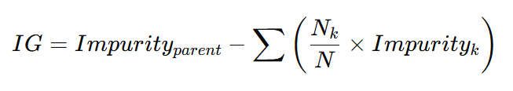
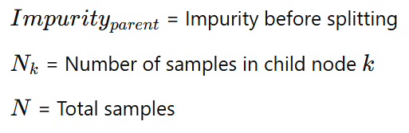
Splitting the Data – Information Gain (How Do We Decide the Best Split?)
If a dataset has Gini = 0.5 before a split, and after splitting it becomes 0.2, the Information Gain is:
IG=0.5−0.2=0.3
A higher IG means a better split.

Slide 42
Step 3: Calculate Information Gain For each attribute
Information Gain (IG) = E(Play) – E (Attribute)
IG (Weather):
IG (Weather) = 1 – 0.599 = 0.401
IG (Temperature):
IG (Temperature) = 1 – 0.886 = 0.114
IG (Humidity):
IG (Humidity) = 1 – 0.964 = 0.036
IG (Wind):
IG (Wind) = 1 – 0.875 = 0.125
A higher IG means a better split.

Slide 43
Step 4: Choose the Best Attribute
The attribute with the highest information gain is selected as the root node:
IG (Weather) = 0.401 (Highest)
Step 5: Repeat for Subsets
Split the dataset based on "Weather" and repeat the process for the subsets until a stopping criterion is met (e.g., pure subsets or no attributes left).

Slide 44
Lab 2: Decision Tree with Entropy

Slide 45
Advantages of DT
Simple to understand and to interpret. Trees can be visualized.
Requires little data preparation. Other techniques often require data normalization, dummy variables need to be created and blank values to be removed. Some tree and algorithm combinations support missing values.
The cost of using the tree (i.e., predicting data) is logarithmic in the number of data points used to train the tree.
Able to handle both numerical and categorical data. However, the scikit-learn implementation does not support categorical variables for now. Other techniques are usually specialized in analyzing datasets that have only one type of variable.
Able to handle multi-output problems.
Uses a white box model. If a given situation is observable in a model, the explanation for the condition is easily explained by boolean logic.
By contrast, in a black box model (e.g., in an artificial neural network), results may be more difficult to interpret.

Slide 46
Challenges in Decision Trees
Overfitting in Decision Trees
Definition: Overfitting occurs when the tree becomes too complex, fitting noise in the training data.
Symptoms: A tree with many branches, low training error, and high test error.
Solution: Pruning the tree, setting maximum depth, minimum samples per leaf, etc.

Slide 47
How to address Overfitting
Pre-Pruning (Early Stopping):
Stop splitting a node if:
The number of samples in the node is below a predefined threshold.
The information gain or impurity reduction is below a threshold.
Example: Limit the tree's maximum depth.
Post-Pruning:
Grow the tree fully, then remove branches that do not improve performance on a validation set.
Techniques include cost-complexity pruning (used in CART).

Slide 48
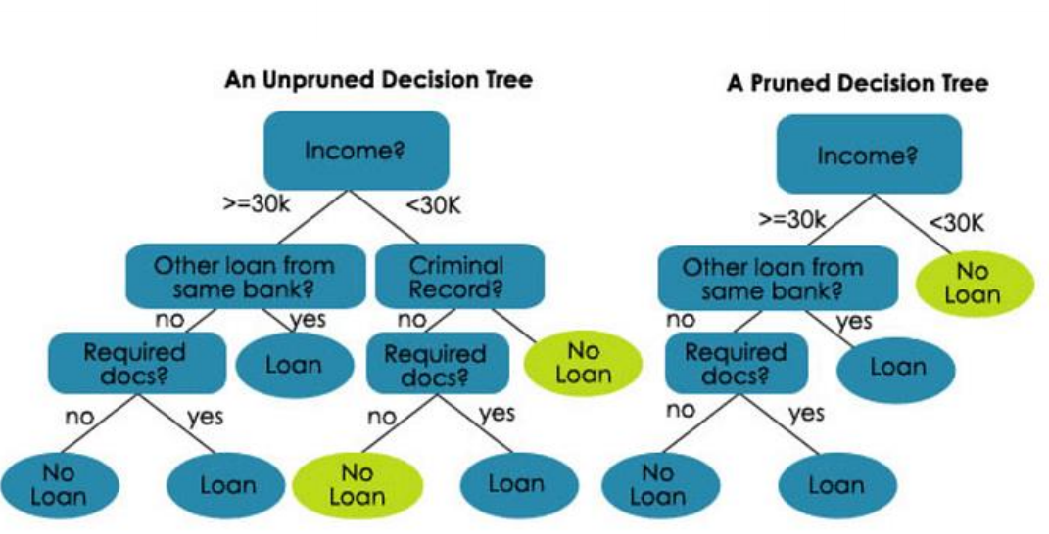
Decision Trees Pruned Vs Unpruned

Slide 49
Key Takeaways
A decision tree is a flowchart-like structure where the data is recursively split into subsets based on feature values.
The model continues splitting the data until it reaches pure or nearly pure subsets at the leaf nodes.
Pruning ensures that the model doesn’t overfit, and the tree remains interpretable and generalizable.

Slide 50
References
[1] https://scikit-learn.org/1.5/modules/tree.html
[2] Alpaydin, E. (2021). Introduction to Machine Learning (4th ed.). MIT Press.

Slide 51
End

